Slide 1
Product Complaint and Field Action Reporting Overview

Slide 2
Product Complaint Reporting
The distributor shall submit a report to Cook Customer Support & Delivery on any device complaints received as soon as Distributor becomes aware of them but no later than 24hrs from date that they were first made aware.
All complaints must be logged by using the Cook Customer Complaint Communication Form provided by Cook Customer Support & Delivery and completed forms should be sent to:
SSCProduct.Complaints@CookMedical.com
European.Complaints@CookMedical.com
Can also be communicated through Indirect Business Manager (IMM)

Slide 3
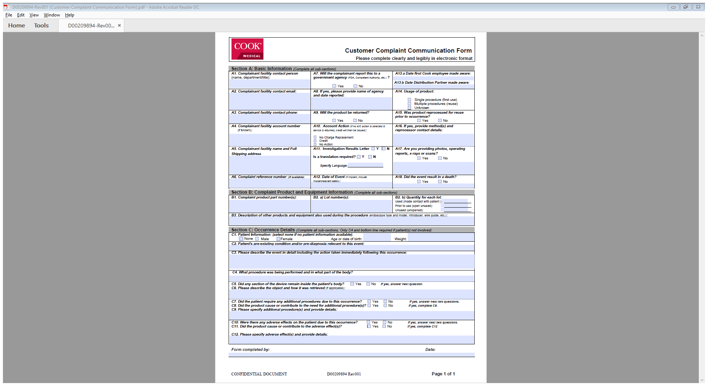
Product Complaint Communication Form

Slide 4
Product Complaint Reporting
Complaint Information is documented in Cook’s Complaint handling software system
The Customer Relations team carries out the following:
Requests as much detailed information as possible
Product specific questions from the manufacturer are asked of the reporter
Requests are made for product return, if available
Free of charge replacements or credit is issued
Acknowledgement letter sent to customer & the appropriate IMM Business Manager
Indirect Business Manager will advise and keep Division Support Manager up to date all the way through the process
Additional inquiries made as requested from the Manufacturer after file transfer

Slide 5
Product Complaint Reporting
During product complaint registration, efforts are made to obtain at a minimum the following 7 key points of information:
Customer information
Date aware
RPN/GPN
Lot #
Quantity involved
Brief description of event
Patient outcome/impact
Upon registration of the product complaint, CSD transfers the record to appropriate Cook Manufacturer-Regulatory Reporting

Slide 6
Regulatory Reporting
Once a complaint is logged on the system, it is sent to the relevant Regulatory Reporting team at the Cook manufacturer.
The Regulatory Reporting team review and assess the data, make a reporting decision, and forward it for peer review.
Once reviewed – it gets transferred to the QE (Quality Engineering) team to carry out the investigation – both reportable and non-reportable complaints.
Complaints can change from being reportable to non-reportable and vice versa during the stages of the investigation depending on information received or the device evaluation results.

Slide 7
Customer Support Center
Upon completion of complaint investigation by the Cook manufacturer, the file is transferred to the Customer Support Center for final closure.
The Customer Support Center carries out the following:
Reviews record to insure all customer actions required are completed; these can include the following:
Credit
Custom letter on investigation findings
Educational session
Free of charge replacement
Sales Representative follow-up
Telephone Call
File is closed upon completion of activities

Slide 8
Complaint/Adverse Event/Incident/Field Action Reporting
In the event of a Field Action / Recall the distributor will be given instructions by Cook on actions to be taken. The distributor will be provided with a list of impacted Products and will be requested to contact the end-customers in receipt of those Products. In the event that, Products need to be returned to Cook they will need to be retrieved and returned by the Distributor. Each Field Action / Recall will be dealt with on a case by case basis.
When notified of a reportable Adverse event/incident, the distributor will assess for reportability in their region and will submit the relevant report to the relevant authority as required. The distributor will notify Cook of any communication they receive from the Competent Authority or Customer in relation to an Adverse Event.
The distributor shall cooperate with Cook in connection with any hold, stop distribution or recall order issued in connection with Products.

Slide 9
EMEA Complaints Process
IMM Division Support Manager
SSCProduct.Complaints@CookMedical.com
European.Complaints@CookMedical.com
& Indirect Business Manager
IBM will ensure that DSM is advised and kept up to date
Distributor
Manufacturer-Regulatory Reporting
Manufacturer-Regulatory Reporting
Manufacturer-
Quality Engineering
Customer Support
Center

