Slide 1
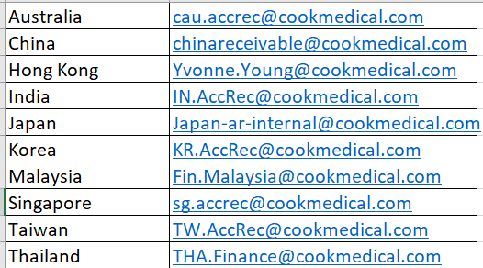
INVOICING
Invoices are generated once purchase orders are received & shipments are completed from the warehouses
For Singapore who export to International Distributors, a commercial invoice is also generated
Distributor invoices & credits are sent to designated Distributor email addresses or directly to specific country tax portals if required
Any queries in relation to generated invoices can be sent to the local country finance team or to Ruth Koch, APAC AR Co Ordinator
Notes:
Customer Support Function:
Remote Inventory & Product Events
Operations Teams (all the markets)
Operations market support team (Ocs, Projects)
Quality
Training
DC: Get content of Slide + picture of DC or team

