Slide 1
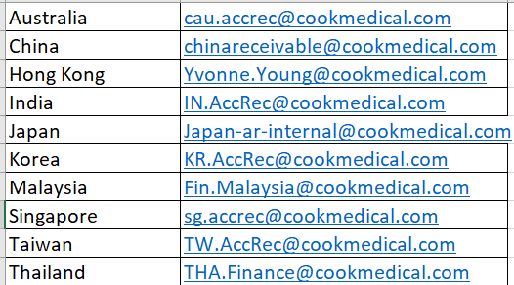
PAYMENT & REMITTANCE INFORMATION
Please send all payment information, your remittance & related queries to the various Accounts Receivable Depts.
Please include your customer account number which helps to identify & process your payment as soon as possible.

