Slide 1
Distributor Resource Hub
Jason Sleath

Slide 2

Total Business Impact
Problem
Indirect Markets have multiple Websites(touchpoints) that all have different locations, not user friendly and creates a negative customer experience. Not all Information is available and not all is accurate. As we move forward we will only be increasing the volume of Touchpoints and Volume of emails and Phone calls looking for information that is up to date and available. Currently not all information required is readily available.

Slide 3

Total Business Impact
Solution
As is process was mapped and defined and one house built with each function having there own front door to house all general up to date information that could be requested on a daily basis by visiting one website
“Lets try and understand what the customer wants before they do”

Slide 4

Total Business Impact
TBIs
Customer experience improved as time to receive the information went from 121.5 days to 129 minutes (just over 2 hrs)

Slide 5

Control – Financial impact
Reducing Carbon Foot print - less emails, fax, telephone etc in this case $ savings like reducing paper, less electricity,
less telephone usage may not be measured by certain dollar value, and may not be that big. A normal email is 4g of CO2,
An email with a big attachment 50g CO2

Slide 6
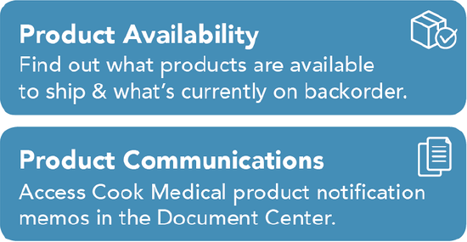
Distributor Portal
The Customer Portal is a solution that can provide our distributors with a self-service option to stay connected. We think that virtual connections are essential to daily operations
The portal includes the following features and more lots more:

Slide 7
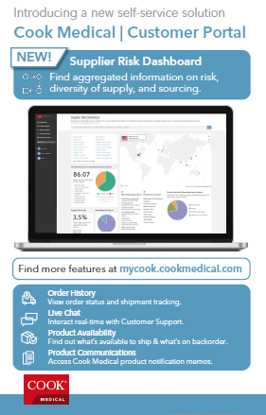
Distribution Resource Hub Access Via Customer Portal
sign in to your account at
https://mycook.cookmedical.com

Slide 8
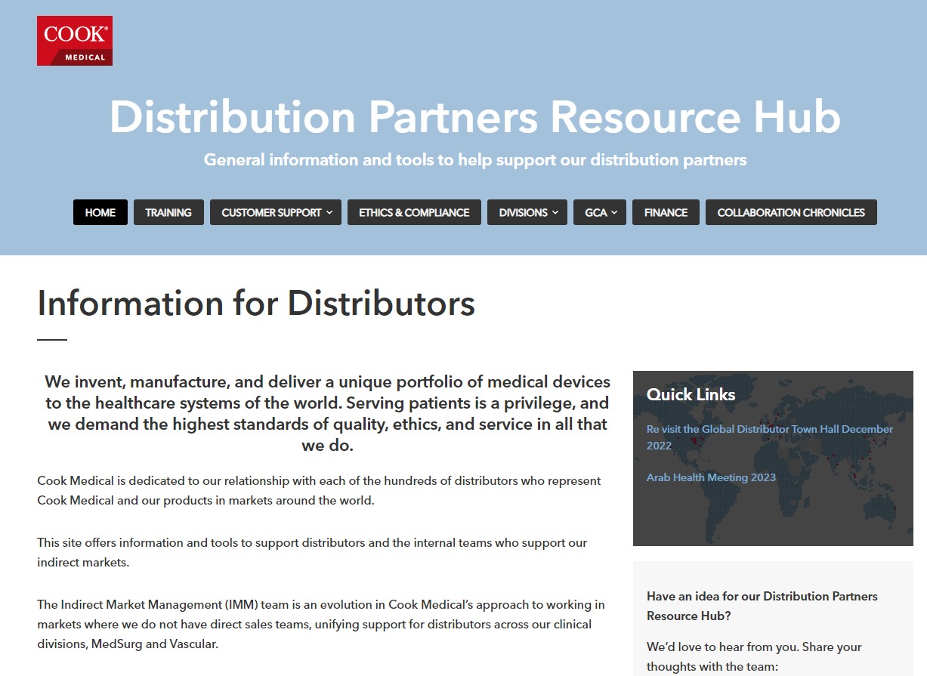
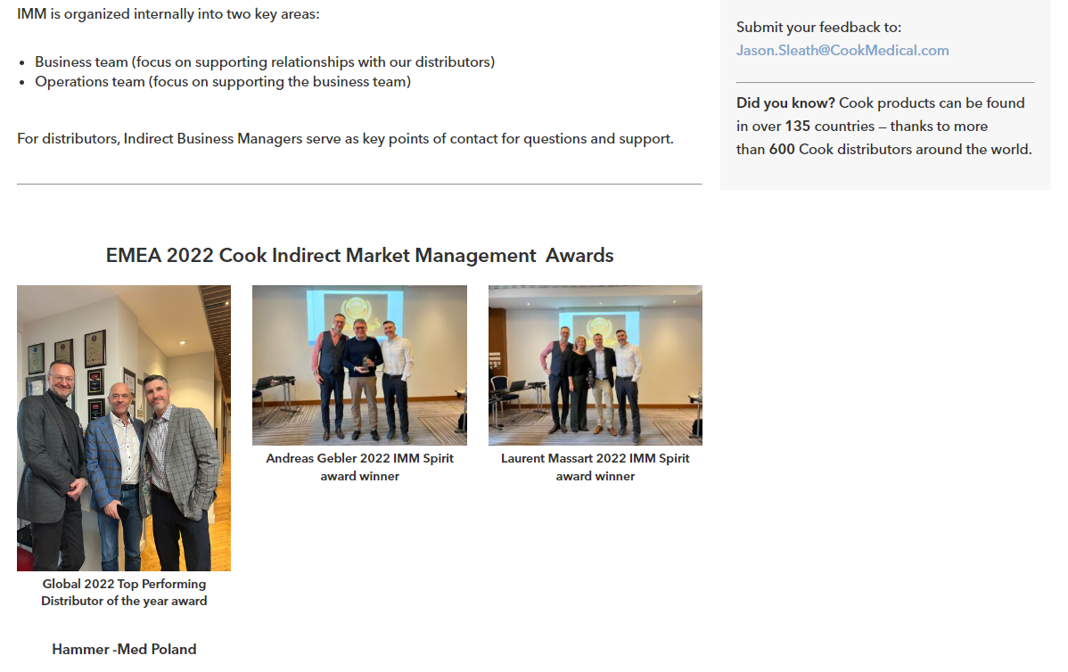
Distribution Partners Resource Hub Landing Page
Notes:
This is the Home page for Distributor General Information

