Slide 1
Cook Learn
Training compliance
Non-Training Compliance
New users
Forgotten password
Corporate training allocation
Clinical/Product training allocation
Active user validation
Roles & Responsibilities
Viewing Training Report

Slide 2
Training compliance
IMM/Cook Learn
IBM
Receives monthly corporate level/ division training report by email
Shares report
Division Support Manager (DSM)
Reviews current & outstanding training & offers support to distributor
Distributor
Discusses with distributor as part of scheduled business planning meeting
Completes training & signs

Slide 3
Non-Compliant Training
Failure to complete the assigned training may be a breach of the distributor’s contractual obligations and is classed as non-compliant. ​
IBM
Receives monthly corporate level/ division training report by email with overdue training
IBM Shares report & Requests letter to be issued from GCA Reminding Distributor of its contractual obligation to complete training
Letter received
Advises GCA & DSM
IBM Requests GCA to send second letter
Letter received
Advises GCA & DSM
IBM Requests GCA to send Final Letter requiring the distributor to complete all training within 30 days and if not completed, Cook will have the right to terminate the distribution agreement. ​
IBM Monitors and keeps all updated
Division Support Manager (DSM)
YES
YES
Distributor
Completes Training
Completes Training
No
No
Issues Letter
Issues Letter
GCA

Slide 4
New users
IMM/Cook Learn
Indirect Business Manager (IBM)
Distributor requests new user be added to Cook Learn
Registration form reviewed, once approved, informs DSM
Division Support Manager (DSM)
Sends new user request to assign training
Operations Support Manager
Received request & send registration link
Distributor
Completes registration process

Slide 5
Forgotten password
IMM/Cook Learn
Distributor
Requests password reminder/reset through Cook Learn
Follows reset instructions
CMH. Learning mailbox
Reset request received & processed

Slide 6
Corporate training allocation
IMM/Cook Learn
Functions
Identifies training to be delivered & contacts IMM for up-to-date distributor listing
Assigns corporate training in Cook Learn
Ops Support Manager
Shares up to date distributor listing with Function
Distributor
Completes training & signs

Slide 7
Clinical/Product training allocation
IMM/Cook Learn
Division training managers
Identifies training to be delivered
Contacts IMM for up-to-date distributor listing
Assigns training in Cook Learn
Receives training request from DSM
Division Support Manager (DSM)
Requests clinical/product training
Distributor
Completes training & signs
Operations Support Manager
Shares up to date distributor listing with Function

Slide 8
Active user validation
IMM/Cook Learn
IBM
Receives monthly Cook Learn active user report by email
If Yes, Deletion/addition requested
If No, no further action required
Operations support manager
Deletion/addition actioned
Distributor
Discusses with distributor as part of scheduled business planning meeting
Changes required
Y/N

Slide 9
Monthly Roles & Responsibilities
IMM/Cook Learn
IBM
Checks user log ins once a month from the generated report
Logged in & Completed
NO
Advises Distributor to immediately log in and complete
No Further Action Required
Advises GCA/IMM Ops to commence non compliant process
Cook Learn
Automatic Email sent to all DPs with Active Cook Learn Accounts advising that they need to Log in and check there account
Yes
Yes
No
Distributor
DP Logs into Cook Learn once a month and checks for any outstanding training and completes
No further action required if DPs have logged in & completed training
Logged in & Completed
GCA
Non-Compliant Process Commences
IMM Operations

Slide 10
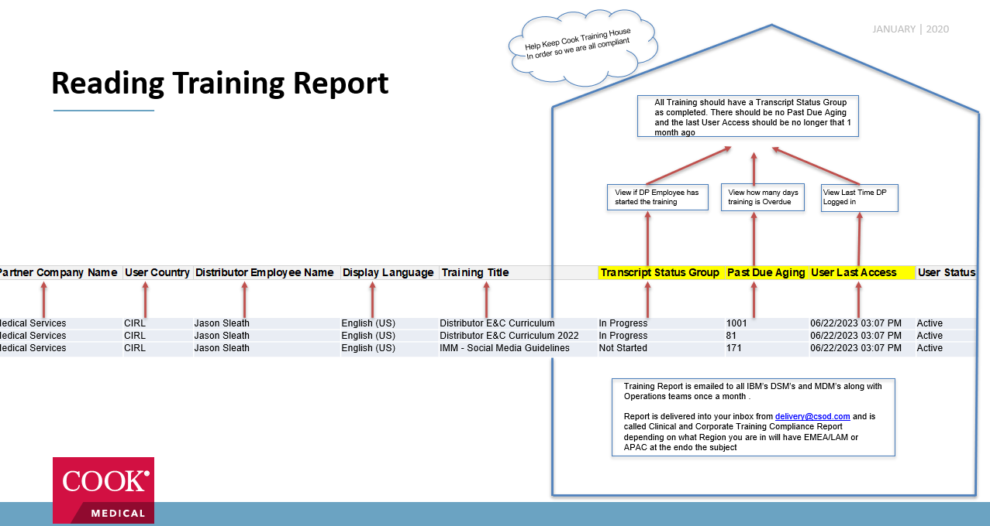
Viewing Training Report
All Training should have a Transcript Status Group as completed. There should be no Past Due Aging and the last User Access should be no longer that 1 month ago
View if DP Employee has started the training
View how many days training is Overdue
View Last Time DP Logged in
Medicl Services | CIRL | Jason Sleath | English (US) | Distributor E&C Curriculum | In Progress | 1001 | 06/22/2023 03:07 PM | Active
Medical Services | CIRL | Jason Sleath | English (US) | Distributor E&C Curriculum 2022 | In Progress | 81 | 06/22/2023 03:07 PM | Active
Medical Services | CIRL | Jason Sleath | English (US) | IMM - Social Media Guidelines | Not Started | 171 | 06/22/2023 03:07 PM | Active
Training Report is emailed to all IBM’s DSM’s and MDM’s along with Operations teams once a month .
Report is delivered into your inbox from delivery@csod.com and is called Clinical and Corporate Training Compliance Report depending on what Region you are in will have EMEA/LAM or APAC at the endo the subject

