Slide 1
Distributor Training Compliance and Accountability Overview

Slide 2
WHY IS TRAINING ASSIGNED
Cook is committed to investing in our distributors and providing the resources needed to ensure each distributor has sufficient expertise to sell and promote Cook products in a compliant manner. Ensuring that our Distributors are, and remain, properly trained is a top priority for Cook.
Training gives our distributors opportunities to grow their knowledge and job skills to become effective.
Training ensures distributors have skills and knowledge equal to the changing industry.
Training standardizes processes and ensures consistent results.
Training ensures alignment with Cook’s mission, vision, values, ethics and policies.
Supports the company to follow laws, reduce risks, and operate effectively.
Supports Compliance.

Slide 3
IS TRAINING REQUIRED?
The distribution agreement sets out the obligations of Cook and the distributor in respect of training. Cook’s obligation is (subject to reasonable capacity and availability, and upon written request) to support the distributor in its education and training of the distributor’s employees.

Slide 4
HOW IS TRAINING COMPLETED
All distributor employees who represent Cook Medical in indirect markets should be registered in Cook’s learning management system, Cook Learn.
Training is assigned to all employees via Cook Learn.
All distributor employees who represent Cook Medical in indirect markets must log into Cook Learn once a month and complete any assigned training.
Distributor employees will receive email notification of all training assignments from cmh.learning@cookmedical.com. Each training will have a date by which the training is due. Training is required to be completed by the due date.
Your Indirect Business Manager (IBM) will provide a current list of active employees during quarterly reviews.
It is imperative the distributor keep the list of active employees in Cook Learn up to date.

Slide 5
REPORTING
Training reports are generated monthly.
Your IBM will work with your company to ensure there is no overdue training.
The IBM will also be checking the date Cook Learn was last accessed to ensure that the system was accessed within the last month and that there is no overdue training.
Training will be a key focus area on the agenda during business planning and quarterly reviews with the Distributor.

Slide 6
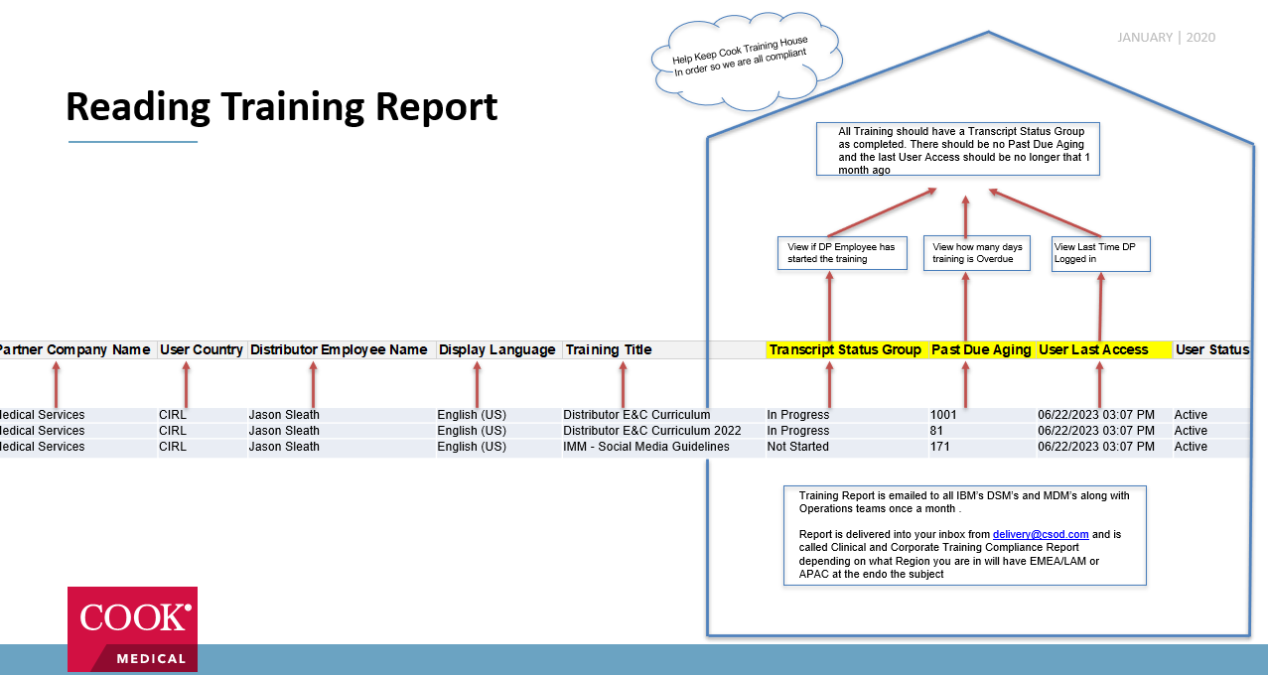
Viewing Training Report
All Training should have a Transcript Status Group as completed. There should be no Past Due Aging and the last User Access should be no longer that 1 month ago
View if DP Employee has started the training
View how many days training is Overdue
View Last Time DP Logged in
Medicl Services | CIRL | Jason Sleath | English (US) | Distributor E&C Curriculum | In Progress | 1001 | 06/22/2023 03:07 PM | Active
Medical Services | CIRL | Jason Sleath | English (US) | Distributor E&C Curriculum 2022 | In Progress | 81 | 06/22/2023 03:07 PM | Active
Medical Services | CIRL | Jason Sleath | English (US) | IMM - Social Media Guidelines | Not Started | 171 | 06/22/2023 03:07 PM | Active
Training Report is emailed to all IBM’s DSM’s and MDM’s along with Operations teams once a month .
Report is delivered into your inbox from delivery@csod.com and is called Clinical and Corporate Training Compliance Report depending on what Region you are in will have EMEA/LAM or APAC at the endo the subject

Slide 7
TRAINING REPORT DETAILS
Distributor Name
User Full Name
Specialty
Function
Training Title
Transcript Status
  Completed
  Started
  Not Started
  Past Due (how many days past the deadline is the training)
  User last accessed training(must not be greater than 1 month)

Slide 8
PROCESS FLOW
Distributor receives email notification of training assignment and logs in to Cook Learn to complete training: https://cookmedical.csod.com/client/cookmedical/default.aspx
Training is assigned to distributor user with due date.
Distributor will find training to be completed on the Welcome Page under My Training or by clicking on My Transcript (best practice).
Distributor completes training on or before the due date and the user transcript is updated accordingly.
Cook Learn is updated Accordingly

Slide 9
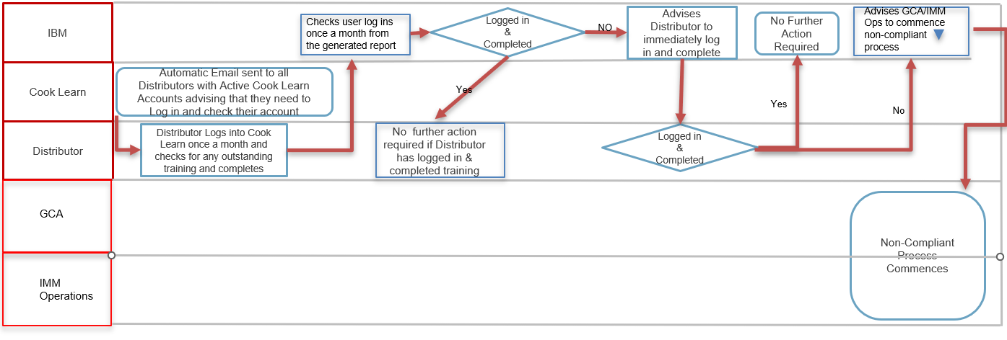
Monthly Roles & Responsibilities
IMM/Cook Learn
IBM
Checks user log ins once a month from the generated report
Logged in & Completed
NO
Advises Distributor to immediately log in and complete
No Further Action Required
Advises GCA/IMM Ops to commence non-compliant process
Cook Learn
Automatic Email sent to all Distributors with Active Cook Learn Accounts advising that they need to Log in and check their account
Yes
Yes
No
Distributor
Distributor Logs into Cook Learn once a month and checks for any outstanding training and completes
No further action required if Distributor has logged in & completed training
Logged in & Completed
GCA
Non-Compliant Process Commences
IMM Operations

Slide 10
Training Notifications
Distributors are notified once a month to log into Cook Learn and complete any outstanding training.
Distributors are notified of training as soon as training is assigned via Cook Learn.
Distributors are notified every day via email once training has 10 days left to complete (up to 5th day remaining).
Distributors are notified daily where training is required to be completed within the next 5 days. IBM and IMM training manager are also copied on this automatic email.
If training is still not completed and is past due a mail is automatically sent to Distributor and escalated to IBM and IMM Ops. IBM will immediately contact Distributor to ensure training is completed.
After step 5 the Noncompliance process begins
After step 5 the Noncompliance process begins.

Slide 11
Non-Compliant Training
Failure to complete the assigned training may be a breach of the distributor’s contractual obligations.
Non-Compliant training will have consequences as follows;
  Training that is overdue is immediately flagged to the IBM;
  IBM will notify the Distributor and insist that the training is completed as soon as possible.
  After step 5 the Noncompliance process begins

Slide 12
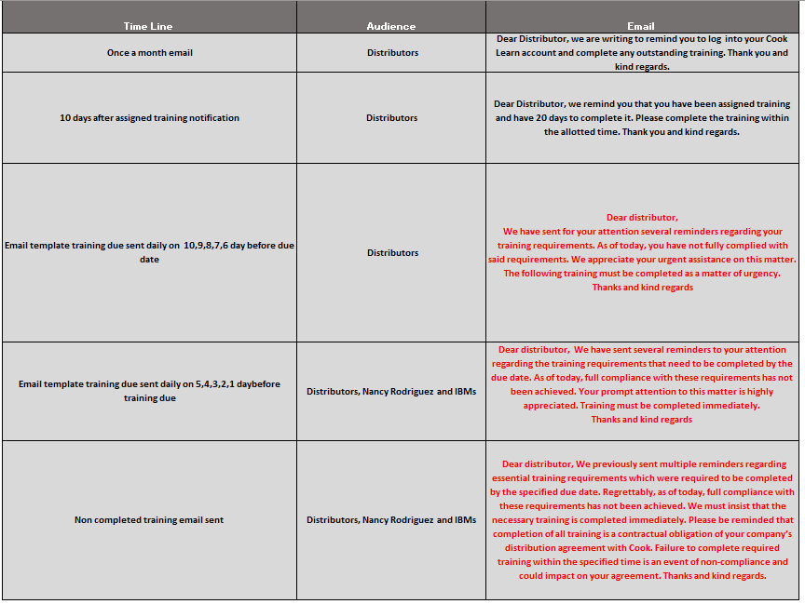
Training Notifications
Cook Learn notification
After 10 days reminder notification
On day 10,9,8,7,6 leading to the due date another reminder is sent
On day 5,4,3,2,1 leading to the due date another reminder is sent copying IBM and training manager
On day after due date a non completed email is sent copying IBM and training manager
Noncompliance process starts

